Slide 1
WHYPER: Towards Automating Risk Assessment of Mobile Applications
Presented by: Xiaoming Ji
University of Illinois at Urbana-Champaign

Slide 2
Introduction
App Markets Security Challenge
How to identify an app is not a malware or doesn't infringe privacy?
Previous Solution
Google Play
Bouncer provides static and dynamic for malware analysis
User grant permission: READ_CONTACTS, READ_CALENDAR, RECORD_AUDIO
Apple App Store:
Manual review process
User grant permission
The Problem
Labor Intensive
End user has hard time to judge whether the permissions asked by the app are valid
WHYPER: “Why Permission”
A new framework to bridge the semantic gap between what the user expects an application to do and what it actually does

Slide 3
Key Contribution
Use of NLP techniques to help bridge the semantic gap between what mobile applications do and what users expect them to do
The first attempt to automate this inference
Evaluation demonstrates substantial improvement over a basic keyword-based searching
Provide a publicly available prototype implementation

Slide 4
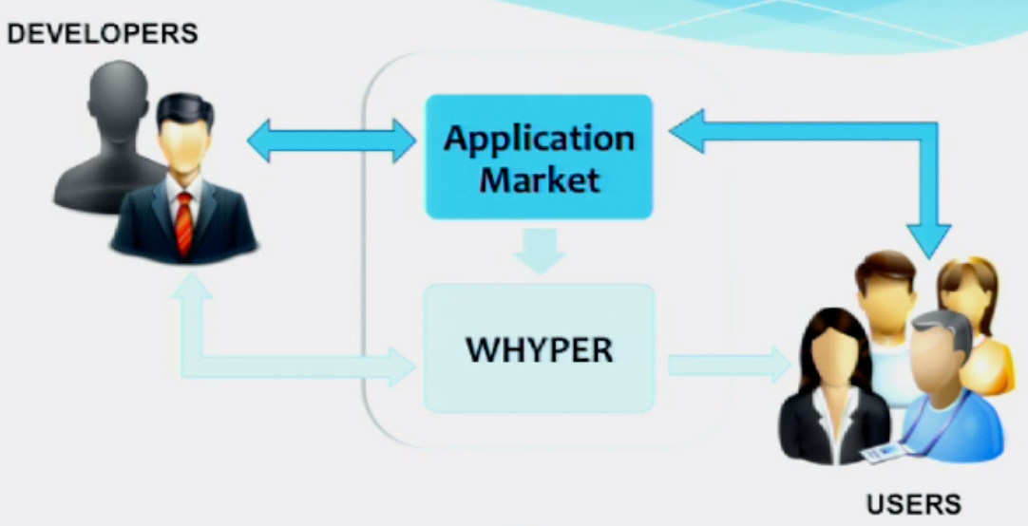
WHYPER Overview

Slide 5
Use Cases
For app user
Enhance user experience
For app developer
Enforce functionality disclosure
For app reviewer
Ensure more appropriate justification

Slide 6
Why Keyword-based Search Doesn’t Work Well
Confounding Effects
Certain keywords such as “contact” have a confounding meaning
For instance: ‘...displays user contacts...’ vs ‘...contact me at abc@xyz.com’
Semantic Inference
Sentences often describe a sensitive operation such as reading contacts without actually referring to keyword “contact”
For instance: “share... with your friends via email, sms”

Slide 7
NLP Preliminaries
Parts Of Speech (POS) Tagging
E.g., nouns, verbs
Phrase and Clause Parsing
Enhances the syntax of a sentence by dividing it into a constituent set of words (or phrases) that logically belong together
Stanford-Typed Dependencies
Hierarchical semantic structure for a sentence
Named Entity Recognition
E.g., ‘Pandora internet radio’, ‘Google maps’ are names, ‘$5’ refer to a currency amount

Slide 8
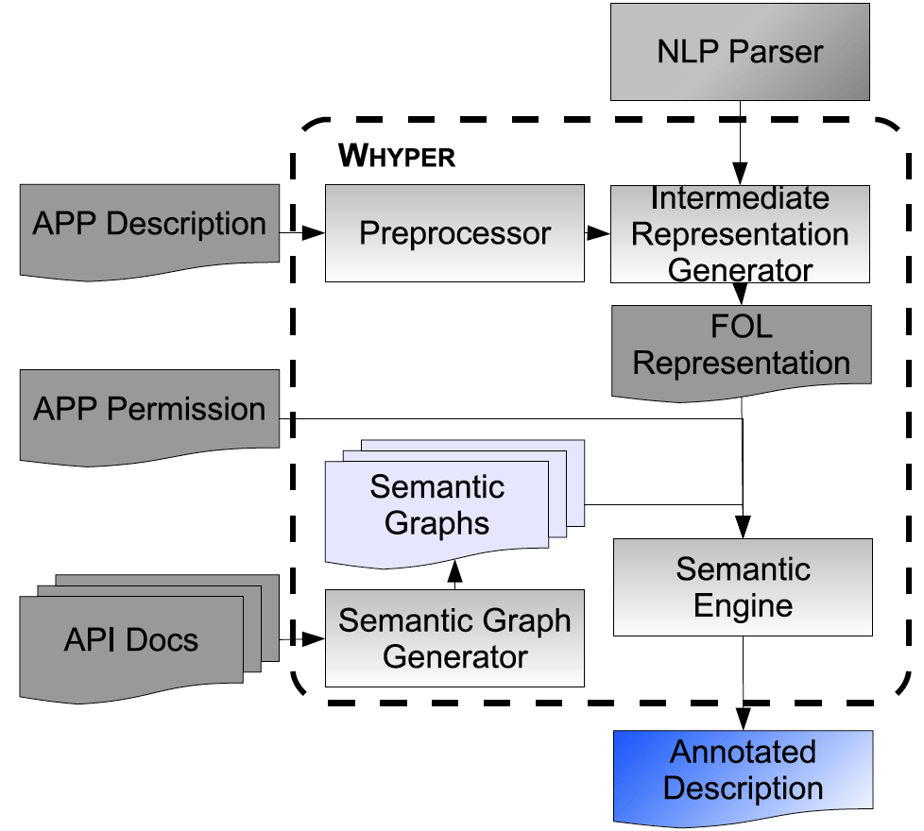
WHYPER Design

Slide 9
Preprocessor

Slide 10
Preprocessor
Period Handling
Handles decimal, ellipsis(‘...’), shorthand notations (“Mr.”, “Dr.”, “e.g.”) for accurate detection of sentence boundaries
Sentence Boundaries
Use tabs, bullet points, delimiters (’;’) to detect appropriate boundaries
Break down enumeration sentence
Named Entity Handling
Annotate Named Entities (E.g., “Pandora internet radio”, “Google maps”) as single lexical units
Abbreviation Handling
Detecting by using the common structure of abbreviations and encoding such structures into regular expressions
Annotate them as a single entity

Slide 11
NLP Parser

Slide 12
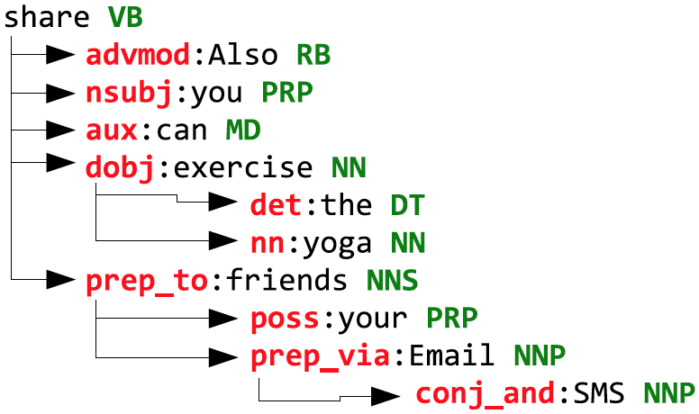
NLP Parser
Named Entity Recognition
NLP parser identifies named entities and added them to the lookup table to be used by pre-processor
Stanford-Typed Dependencies
Simple description of the grammatical relationships in a sentence
Extraction of textual relationships
“Also you can share the yoga exercise to your
friends via Email and SMS”

Slide 13
Intermediate-Representation Generator

Slide 14
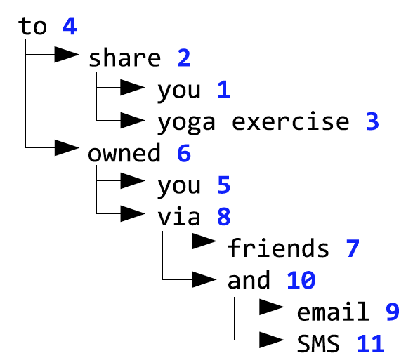
Intermediate-Representation Generator
Input: Standford-typed dependencies
Output: First-Order-Logic (FOL) expression
Every node in the tree except for the leaf nodes is a predicate node.
Leaf nodes represent the entities
Algorithm: Principle shallow parsing
Purpose: use FOL representation to deal with the problem of confounding effects

Slide 15
Semantic Engine (SE)

Slide 16
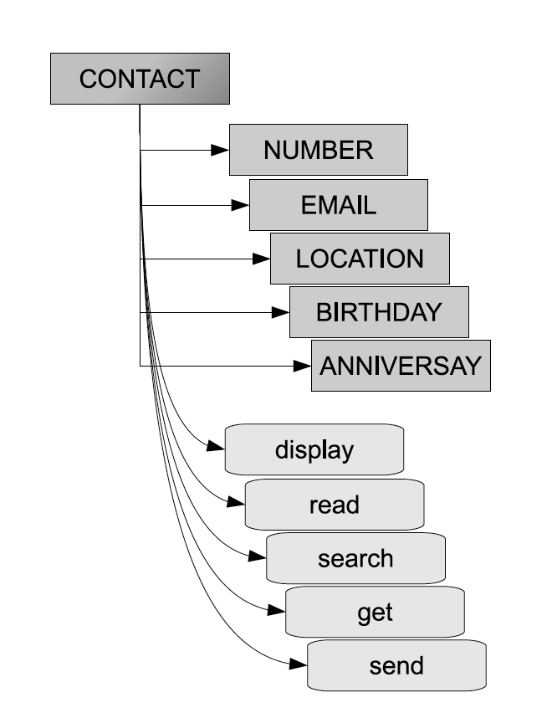
Match Description with Permission Semantic Graph
FOL for “Also you can share the yoga exercise to your
friends via Email and SMS”
Semantic Graph for the READ_CONTACT
permission
WordNet Similarity

Slide 17
Semantic-Graph Generator

Slide 18
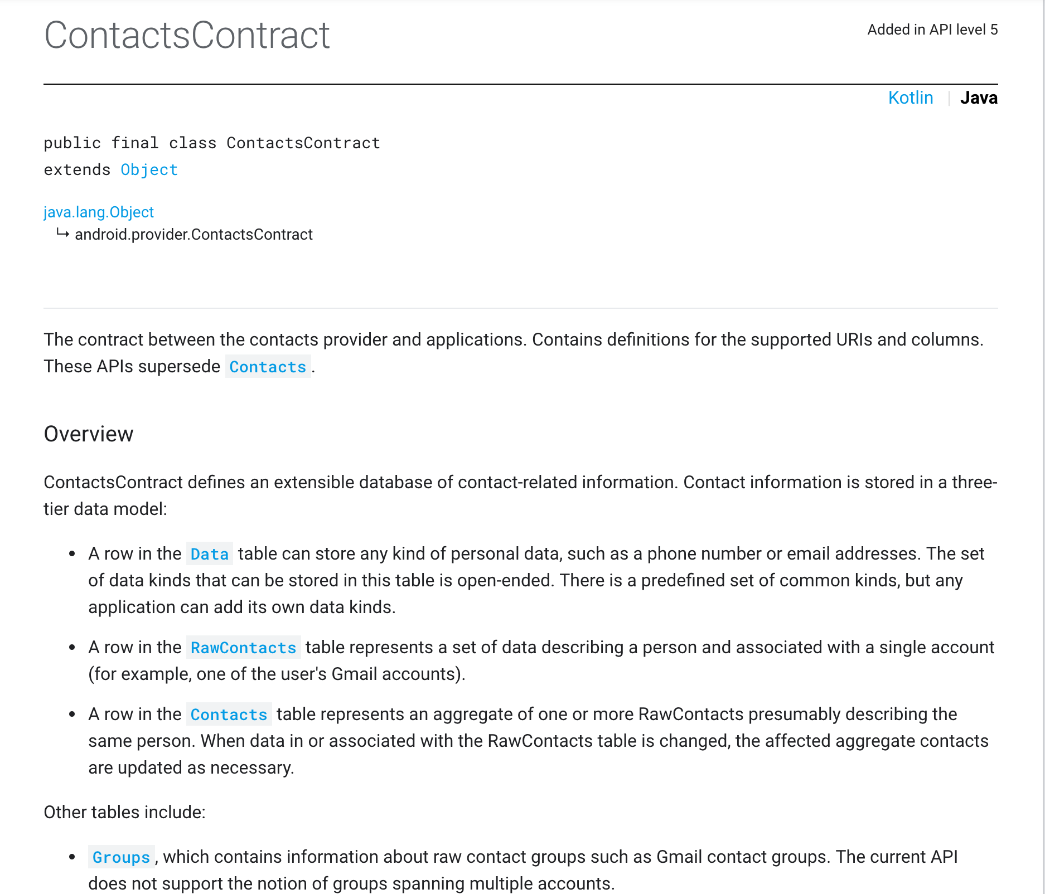
Semantic-Graph Generator
WHY
Build knowledge graph to represent a specific permission. E.g., READ_CONTACT
HOW
Infer graphs from API documents

Slide 19
Semantic-Graph Generator
Resource
Use Pscout to find class/interface pertaining to a particular permission
E.g., analyze ContactsContract.Contacts class document and find READ_CONTACT permission is associated with this class
Identify the corresponding resource associated the class/interface
Typically class name. E.g., ‘CONTACTS’ from the ContactsContract.Contacts class that is associated with READ_CONTACT permission
Inspect the member variables and member methods to identify actions and subordinate resources
Subordinate Resources
Actions

Slide 20
Evaluation
Permissions:
READ_CONTACTS
READ_CALENDAR
RECORD_AUDIO
581 application descriptions which contained 9,953 sentences
Research Questions:
RQ1: What are the precision, recall and F-Score of WHYPER in identifying permission sentences (i.e., sentences that describe need for a permission)?
RQ2: How effective WHYPER is in identifying permission sentences, compared to keyword-based searching ?

Slide 21
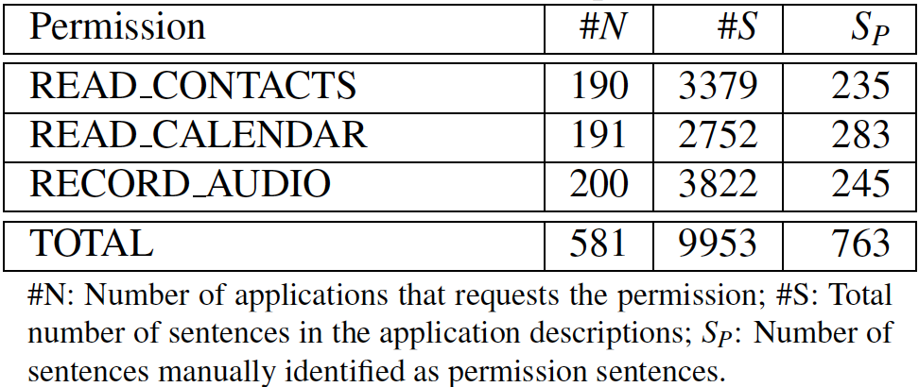
Statistics of Subject permissions

Slide 22
Measurement
True Positive (TP)
A sentence that WHYPER correctly identifies as a permission sentence.
False Positive (FP)
A sentence that WHYPER incorrectly identifies as a permission sentence.
True Negative (TN)
A sentence that WHYPER correctly identifies as not a permission sentence.
False Negative (FN)
A sentence that WHYPER incorrectly identifies as not a permission sentence

Slide 23
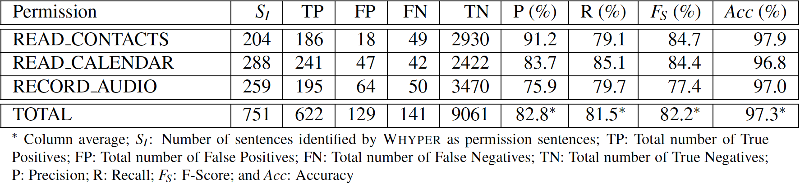
RQ1 Results: Effectiveness in Identifying Permission Sentences

Slide 24
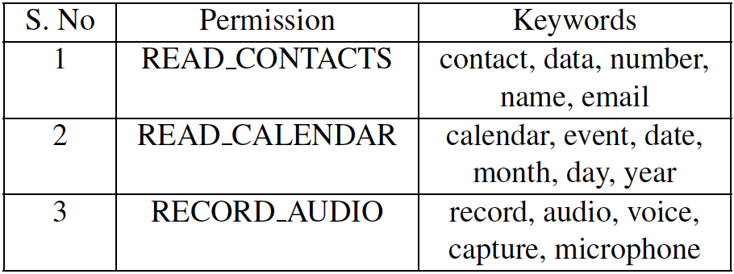
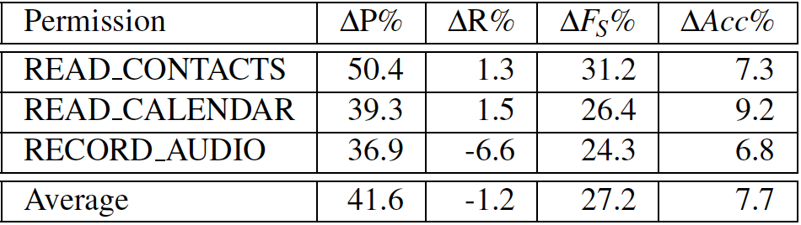
Results RQ2: Comparison to Keyword-based Searching
Keywords for Permissions
Comparison with keyword-based search
The gap in recall can be alleviated by improving the underlying NLP infrastructure and a little manual effort.

Slide 25
Summary
WHYPER: a novel framework that uses Natural Language Processing (NLP) techniques to determine why an application uses a permission.
The evaluation results demonstrate great promise in using NLP techniques to bridge the semantic gap of user expectations to aid the risk assessment of mobile applications.

Slide 26
Discussion
Challenges for WHYPER
Model and evaluation is done only on English description and 3 popular permissions
Need to check the effectiveness on other languages (e.g., Chinese) and permissions which are also critical for user’s privacy (e.g., camera, location)
Broad adoption is hard without support from big app markets
Developer is not motivated to adjust their app descriptions to match permission requirements
Inspiration
Inspired by deep semantic analysis: can we actually use (grammar constraint) natural language to describe how software work?
To build business process automation
Even a DSL-like (domain specific language) new programming language that product manager or business people can use to build software logic. Thus reduce the effort needed for coding and testing tremendously.
(DSL – domain specific language)

Slide 27
Thank You!

Slide 28
Suggested Outline
Start with an explanation of the problem and motivation
What’s the problem/task? Why is it interesting/important?
A brief summary of the contribution of the paper or main ideas of the paper
Roughly follow the structure of the paper itself with focus on
High-level ideas and intuitive explanation
Some technical details, but not a lot; focus on the main ideas and technical approaches
Try to balance the completeness in the coverage of all the content and the highlighting of the major findings/conclusions by giving a relatively complete high-level coverage and selectively going in depth on only a few most interesting points from your perspective
Try to use an example, an illustration, or a diagram to help explain things; avoid using a lot of small font text on a slide.
At the end, include a one-slide summary of the most important take-away messages from this paper, and one slide to list any of your thoughts on any or all of the following: 1) any criticism of the paper (where can be done better), 2) any disagreement with the authors, 3) any new idea inspired by the paper for either further research or development of a useful tool for people to use.

